Slide 1

UCI
Heart Disease Prediction Data
-By Supriya Kamble

Slide 2
Introduction
Cardiovascular diseases have been the most common cause of death worldwide over the last few decades in developed as well as underdeveloped and developing countries. Early detection of cardiac diseases and continuous supervision of clinicians can reduce the mortality rate. However, it is not possible to monitor patients every day in all cases accurately and consultation of a patient for 24 hours by a doctor is not available since it requires more sapience, time, and expertise.
Every day, the average human heart beats around 100,000 times, pumping 2,000 gallons of blood through the body. Inside your body, there are 60,000 miles of blood vessels. The signs of a woman having a heart attack are much less noticeable than the signs of a man. In women, heart attacks may feel uncomfortable squeezing, pressure, fullness, or pain in the center of the chest. It may also cause pain in one or both arms, the back, neck, jaw, stomach, shortness of breath, nausea, and other symptoms.
Men experience typical symptoms of heart attack, such as chest pain, discomfort, and stress. They may also experience pain in other areas, such as arms, neck, back, and jaw, and shortness of breath, sweating, and discomfort that mimics heartburn. It’s a lot of work for an organ which is just like a large fist and weighs between 8 and 12 ounces.

Slide 3
Objective of Data
The objective of the UCI Heart Disease dataset is to facilitate research and analysis aimed at developing predictive models for the detection and assessment of heart disease. Specifically, the dataset aims to:
Enable Prediction: Provide a diverse set of medical attributes and corresponding diagnoses to enable the development of machine learning models capable of predicting the likelihood of heart disease in patients.
Support Research: Serve as a valuable resource for researchers and data scientists interested in studying the factors associated with heart disease and exploring novel approaches to its diagnosis and treatment.
Promote Healthcare Innovation: Foster innovation in healthcare by empowering healthcare providers, businesses, and policymakers with data-driven insights into heart disease risk assessment and management.
Improve Patient Outcomes: Ultimately, the primary objective of the dataset is to contribute to the improvement of patient outcomes by facilitating early detection, intervention, and personalized treatment of heart disease.

Slide 4
How data can help businesses
Healthcare Providers: Hospitals and clinics can use these models to assess the risk of heart disease in patients during routine check-ups. This can lead to early detection and intervention, ultimately improving patient outcomes and reducing healthcare costs.
Insurance Companies: Insurance companies can utilize these models to assess the risk of heart disease in their policyholders. By identifying high-risk individuals, they can offer targeted interventions or wellness programs to mitigate the risk and reduce claims.
Pharmaceutical Companies: Pharmaceutical companies can use predictive models to identify potential candidates for clinical trials of new drugs aimed at preventing or treating heart disease. This can streamline the drug development process and bring new treatments to market more efficiently.
Healthtech Startups: Startups focused on digital health and wellness can develop applications or wearable devices that utilize heart disease prediction models to provide personalized health recommendations to users. This can empower individuals to take proactive steps toward preventing heart disease.

Slide 5
Real-life Applications
Clinical Decision Support: Healthcare professionals can use these models as decision-support tools during patient consultations. By inputting patient data into the model, clinicians can obtain risk scores and recommendations for further evaluation or treatment.
Public Health Initiatives: Public health authorities can utilize predictive models to identify populations at high risk of heart disease and implement targeted prevention strategies, such as educational campaigns, screening programs, or policy interventions.
Remote Monitoring: Remote monitoring devices equipped with heart disease prediction algorithms can continuously monitor individuals at risk and alert them or their caregivers of any significant changes or warning signs, enabling timely medical intervention.
Personalized Medicine: Predictive models can facilitate the shift towards personalized medicine by enabling healthcare providers to tailor treatment plans based on an individual's risk profile and genetic predisposition to heart disease.

Slide 6
About Dataset
This is a multivariate type of dataset which means providing or involving various mathematical or statistical variables, and multivariate numerical data analysis.
It is composed of 14 attributes which are age, sex, chest pain type, resting blood pressure, serum cholesterol, fasting blood sugar, resting electrocardiographic results, maximum heart rate achieved, exercise-induced angina, old peak-ST depression induced by exercise relative to rest, the slope of the peak exercise ST segment, number of major vessels and Thalassemia.
This database includes 76 attributes, but all published studies relate to using a subset of 14 of them. One of the major tasks of this dataset is to predict based on the given attributes of a patient whether that particular person has heart disease or not. The other is the experimental task to diagnose and find out various insights from this dataset which could help in understanding the problem more.

Slide 7
Column Descriptions
id: Unique identifier for each patient
age: Age of the patient in years
origin: Place of study
sex: Gender of the patient
cp: Chest pain type (e.g., typical angina, atypical angina, non-anginal, asymptomatic)
trestbps: Resting blood pressure (mm Hg on admission)
chol: Serum cholesterol level (mg/dl)
fbs: Fasting blood sugar (>120 mg/dl)
restecg: Resting electrocardiographic results
Values: normal, ST-T abnormality, left ventricular hypertrophy
thalach: Maximum heart rate achieved
exang: Exercise-induced angina (True/False)
oldpeak: ST depression induced by exercise relative to rest
slope: Slope of the peak exercise ST segment
ca: Number of major vessels colored by fluoroscopy (0-3)
thal: Thalassemia diagnosis (normal, fixed defect, reversible defect)
num: Predicted attribute indicating presence of heart disease

Slide 8
Challenges
Data Quality: Ensuring the accuracy and reliability of the medical data is crucial for building effective prediction models. Incomplete or inaccurate data can lead to biased or unreliable predictions.
Feature Selection: Identifying the most relevant features or attributes from the dataset that contribute to the prediction of heart disease is essential. This requires domain knowledge and careful analysis of the data.
Imbalanced Data: Imbalance in the distribution of classes (i.e., presence or absence of heart disease) can affect the performance of machine learning algorithms. Techniques such as oversampling, under-sampling, or using algorithms that handle imbalanced data well are necessary to address this issue.
Interpretability: Building models that not only provide accurate predictions but also offer insights into the factors contributing to the prediction is important for gaining trust from healthcare professionals and patients.

Slide 9
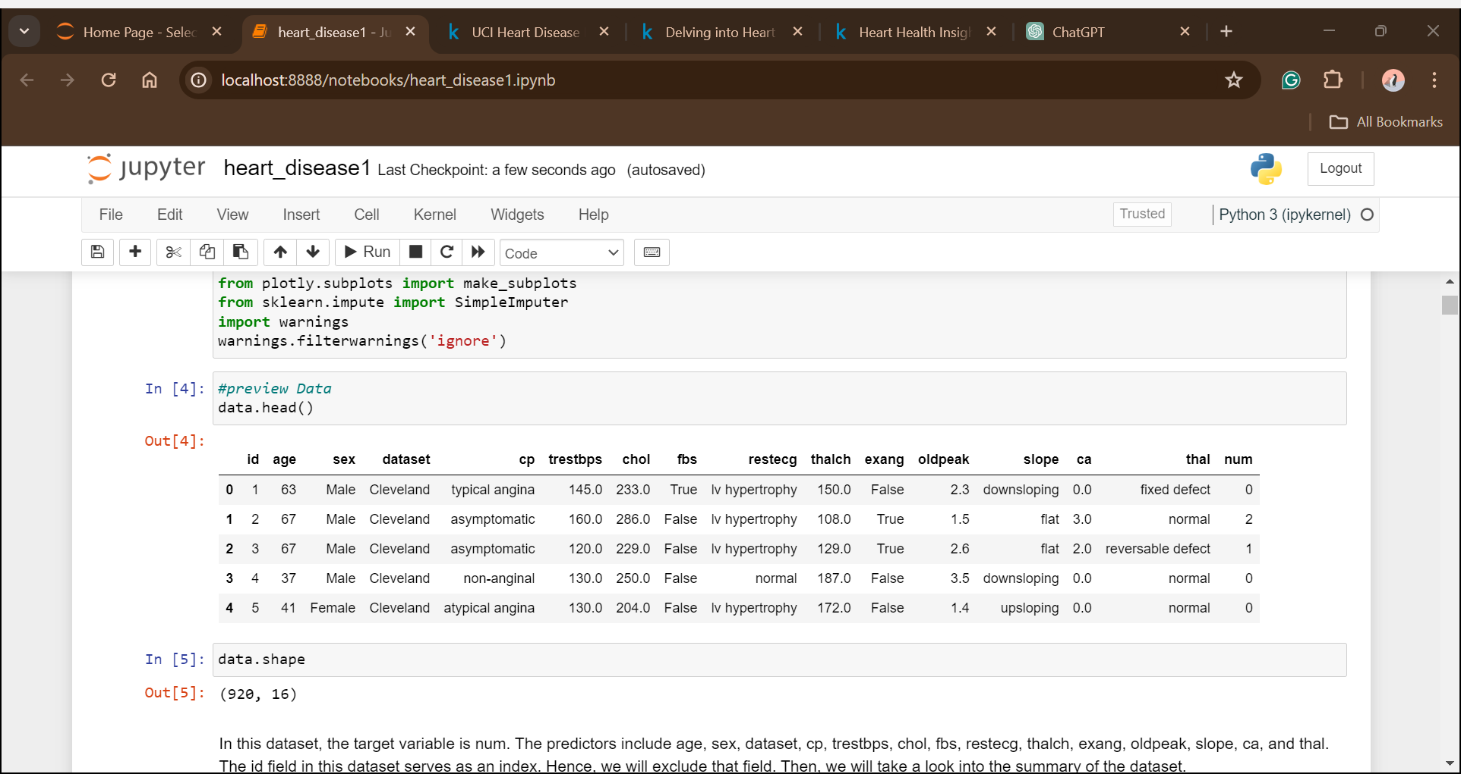
Data Understanding
Begin by loading the dataset into Python Programming. Verifying that the dataset is loaded correctly and examine the first few rows to get a glimpse of the data structure.
The size of the dataset is 920 rows and 16 attributes in which num is the dependent variable for which we have to make the prediction.

Slide 10
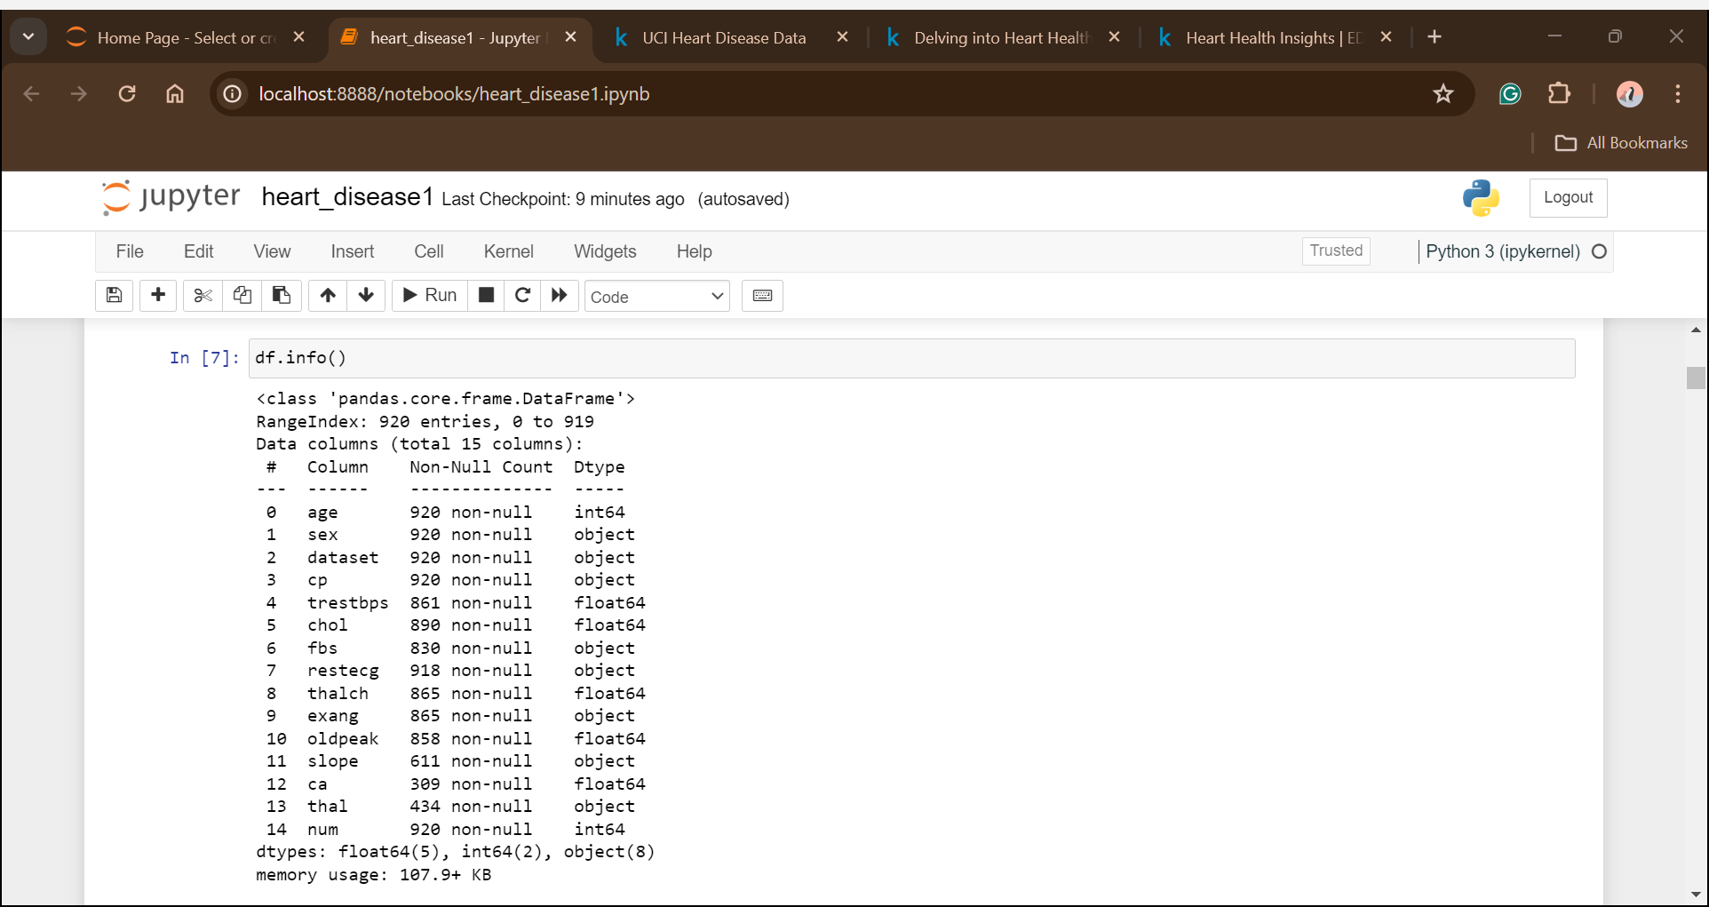
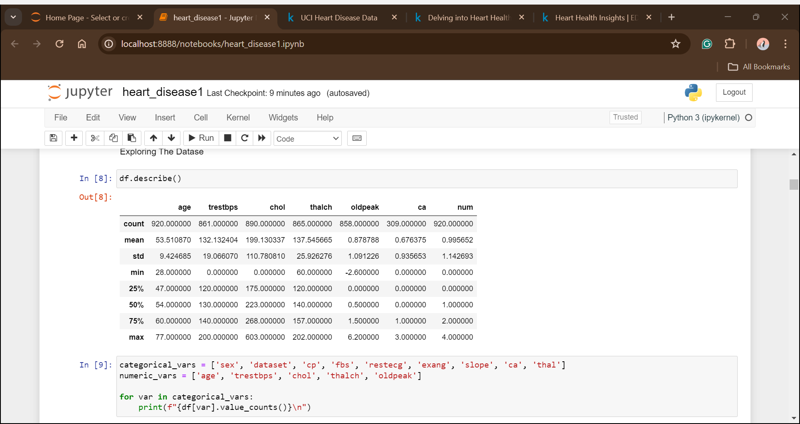
Dataset Overview
Based on the summary above, it appears that the data consists of a total of 920 observations. However, many features in this dataset have missing values, including trestbps, chol, fbs, restecg, thalch, exang, oldpeak, slope, ca, and thal. In addition, the dataset contains both numeric and categorical variables.

Slide 11
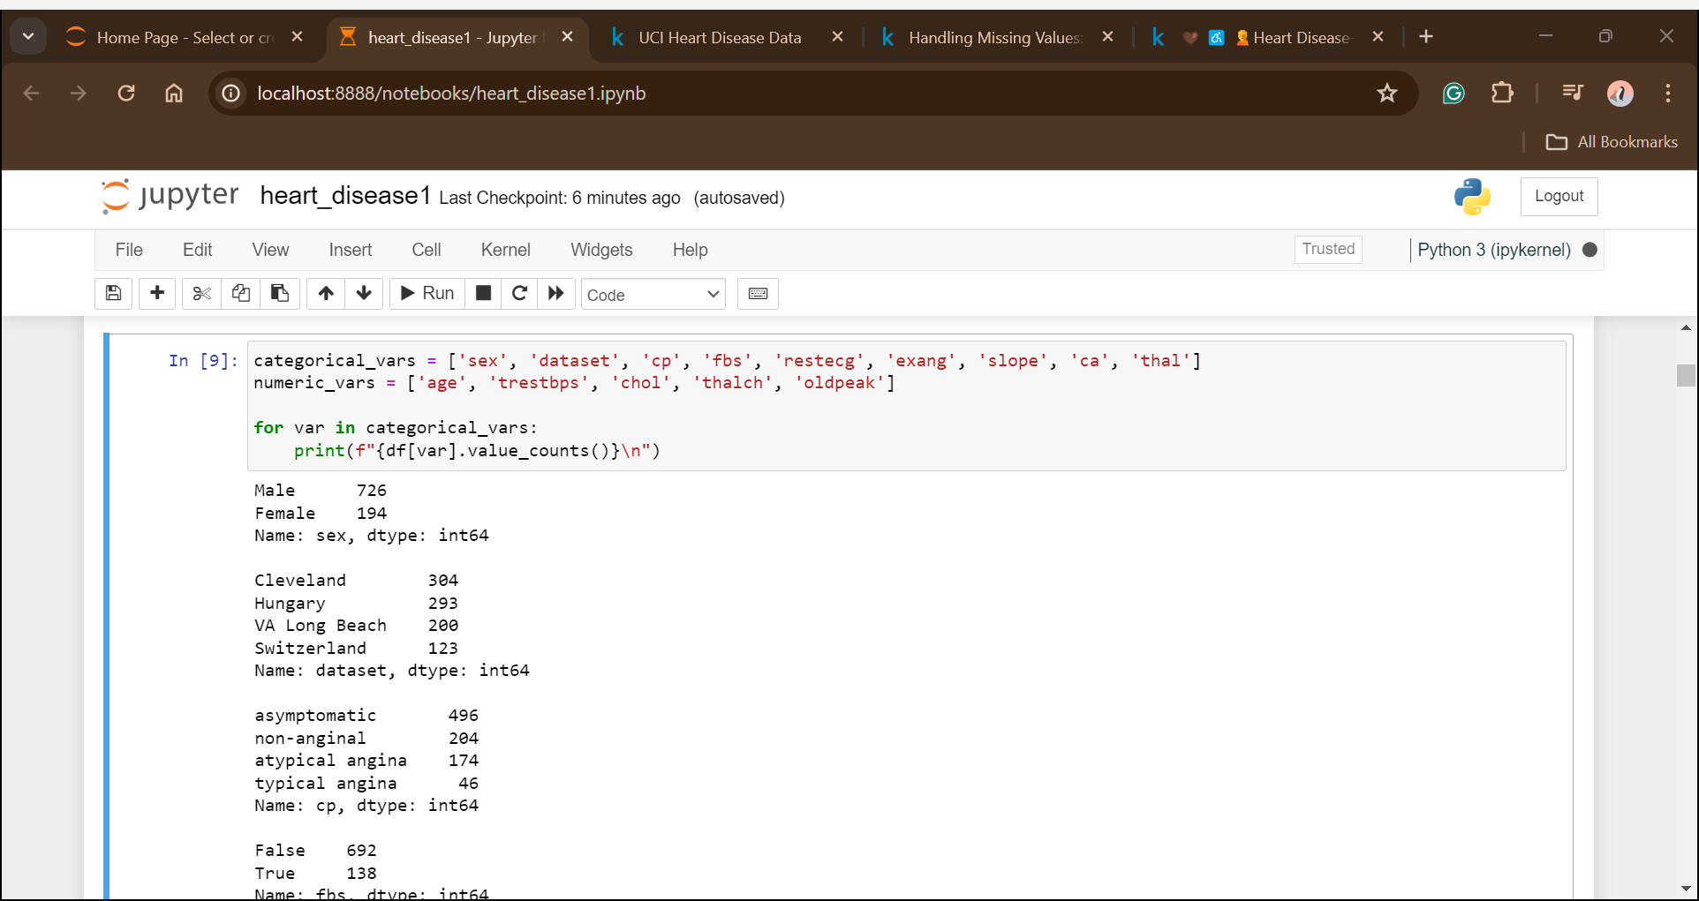
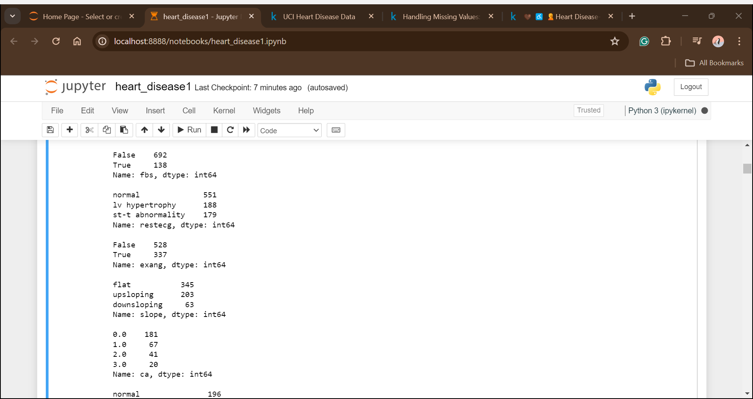
Exploring Numerical and Categorical Features

Slide 12
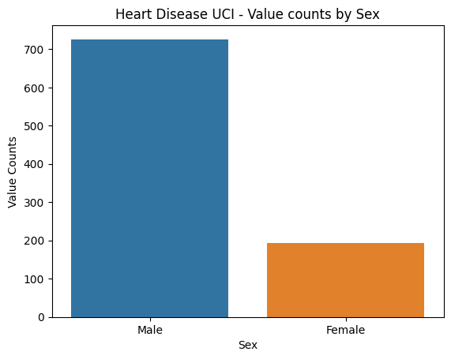
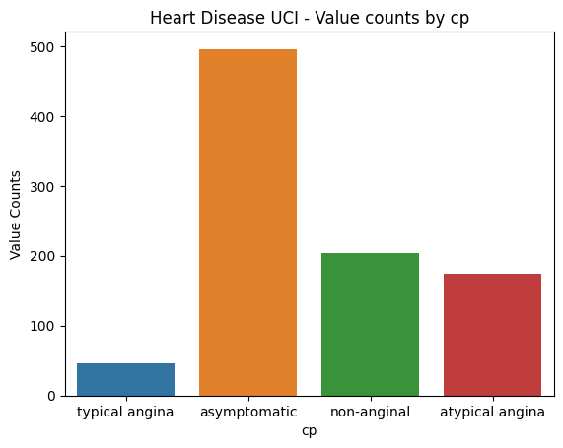
Exploratory Data Analysis (EDA)
Categorical Features – Countplot

Slide 13
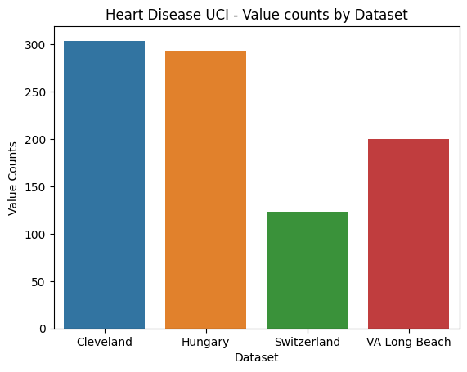
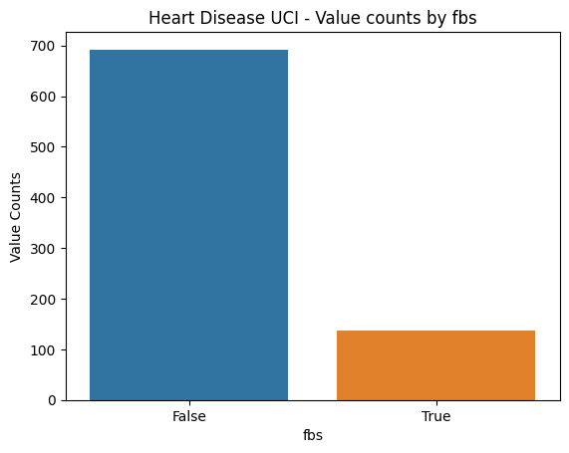

Slide 14
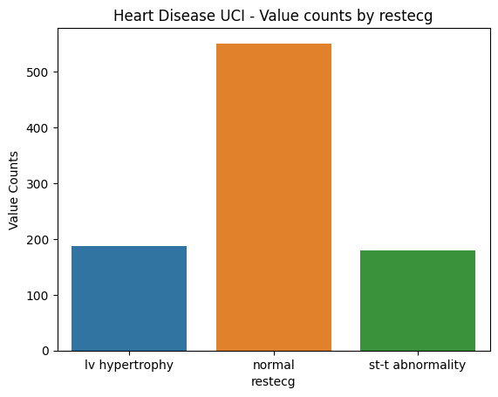
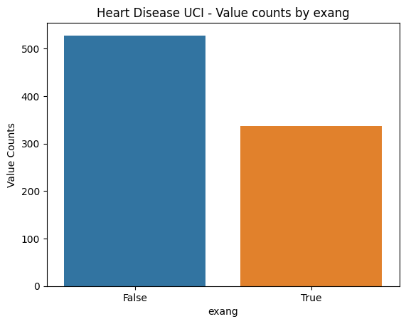

Slide 15
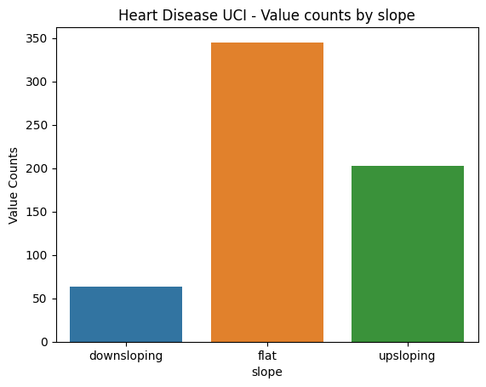
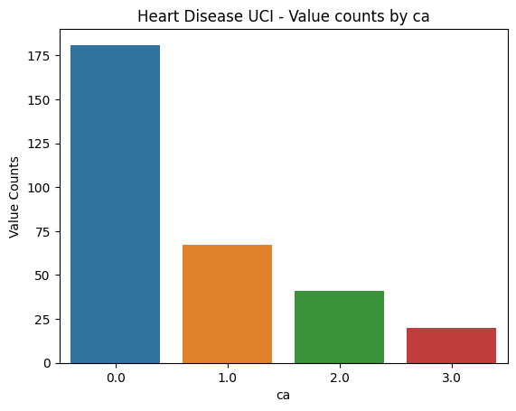

Slide 16
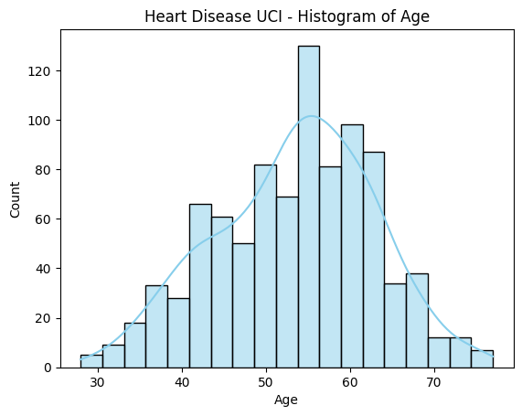
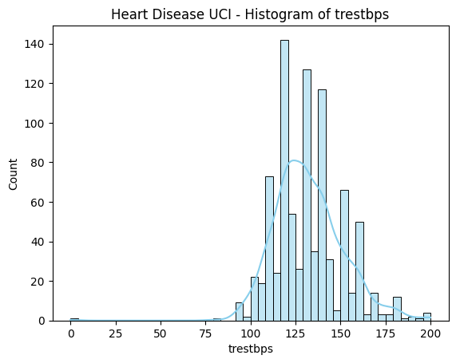
Numerical Features – histplot

Slide 17
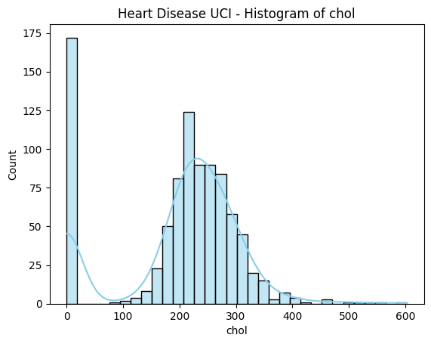
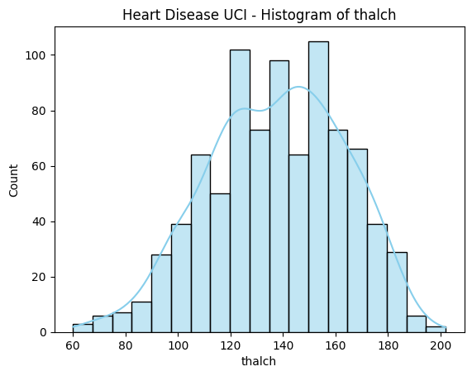

Slide 18
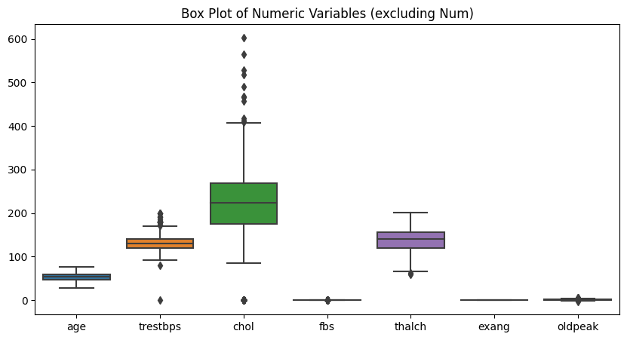
Outlier Detection
Based on the box plot above, trestbps, chol, and thalch exhibit outliers, especially chol. On the contrary, age and exang are two features that do not have outliers.

Slide 19
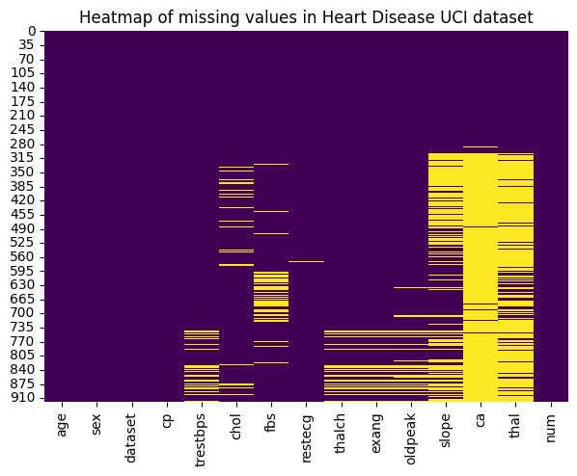
Pattern of Missingness
Based on the heatmap above, missing values appear intensively starting from the 300th row.
The top three variables with the highest number of observations with missing values are slope, ca, and thal.
So far, it does not look like the missing values are distributed randomly.

Slide 20
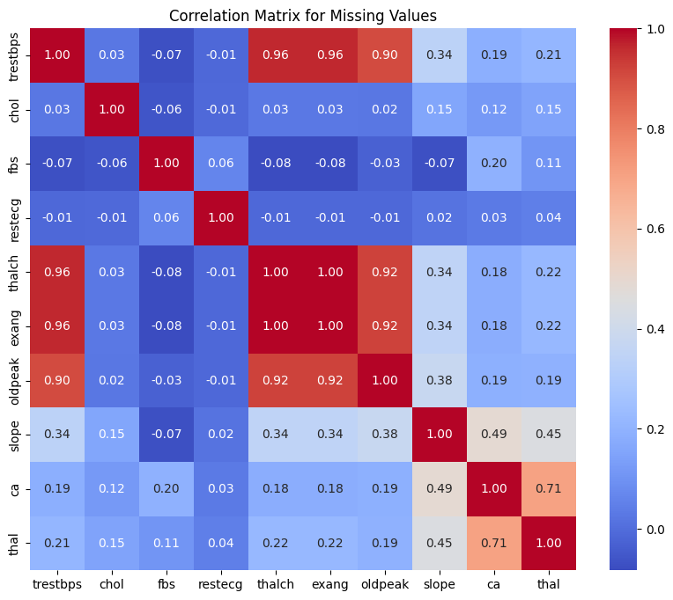
Correlation Matrix
From the heatmap above, we observe a strong relationship of missing values between thalch and trestbps, exang and trestbps, oldpeak and trestbps, etc.
Once again, the pattern of missing values among variables does not appear random.
As we mentioned above, the dataset includes 15 variables. However, at least 10 variables have missing values.
Hence, we will apply 2 imputation methods (Median/Mode imputation and Random Forest imputation) to fill in the missing values.

Slide 21
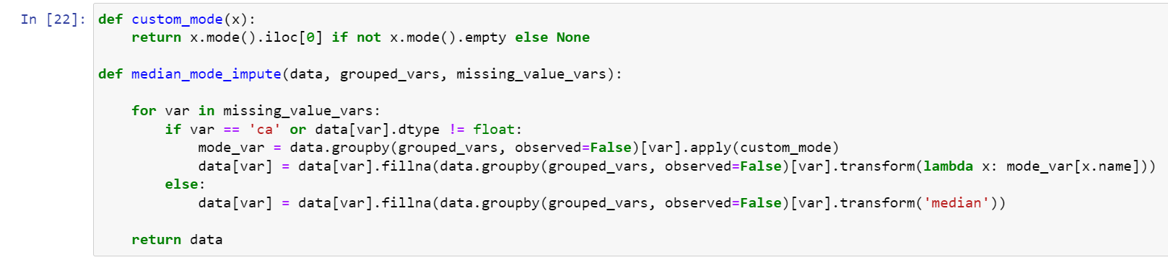
Imputing Missing Values
Median/Mode Imputation
We will start by trying the simplest imputation method, which is Median/Mode Imputation, to fill in missing values
we will fill in the missing values by inputting the median value if the feature is numerical. For categorical features,
we will use the mode value to replace the missing values.
Numeric variables ==> median value
Categorical variables ==> mode value

Slide 22
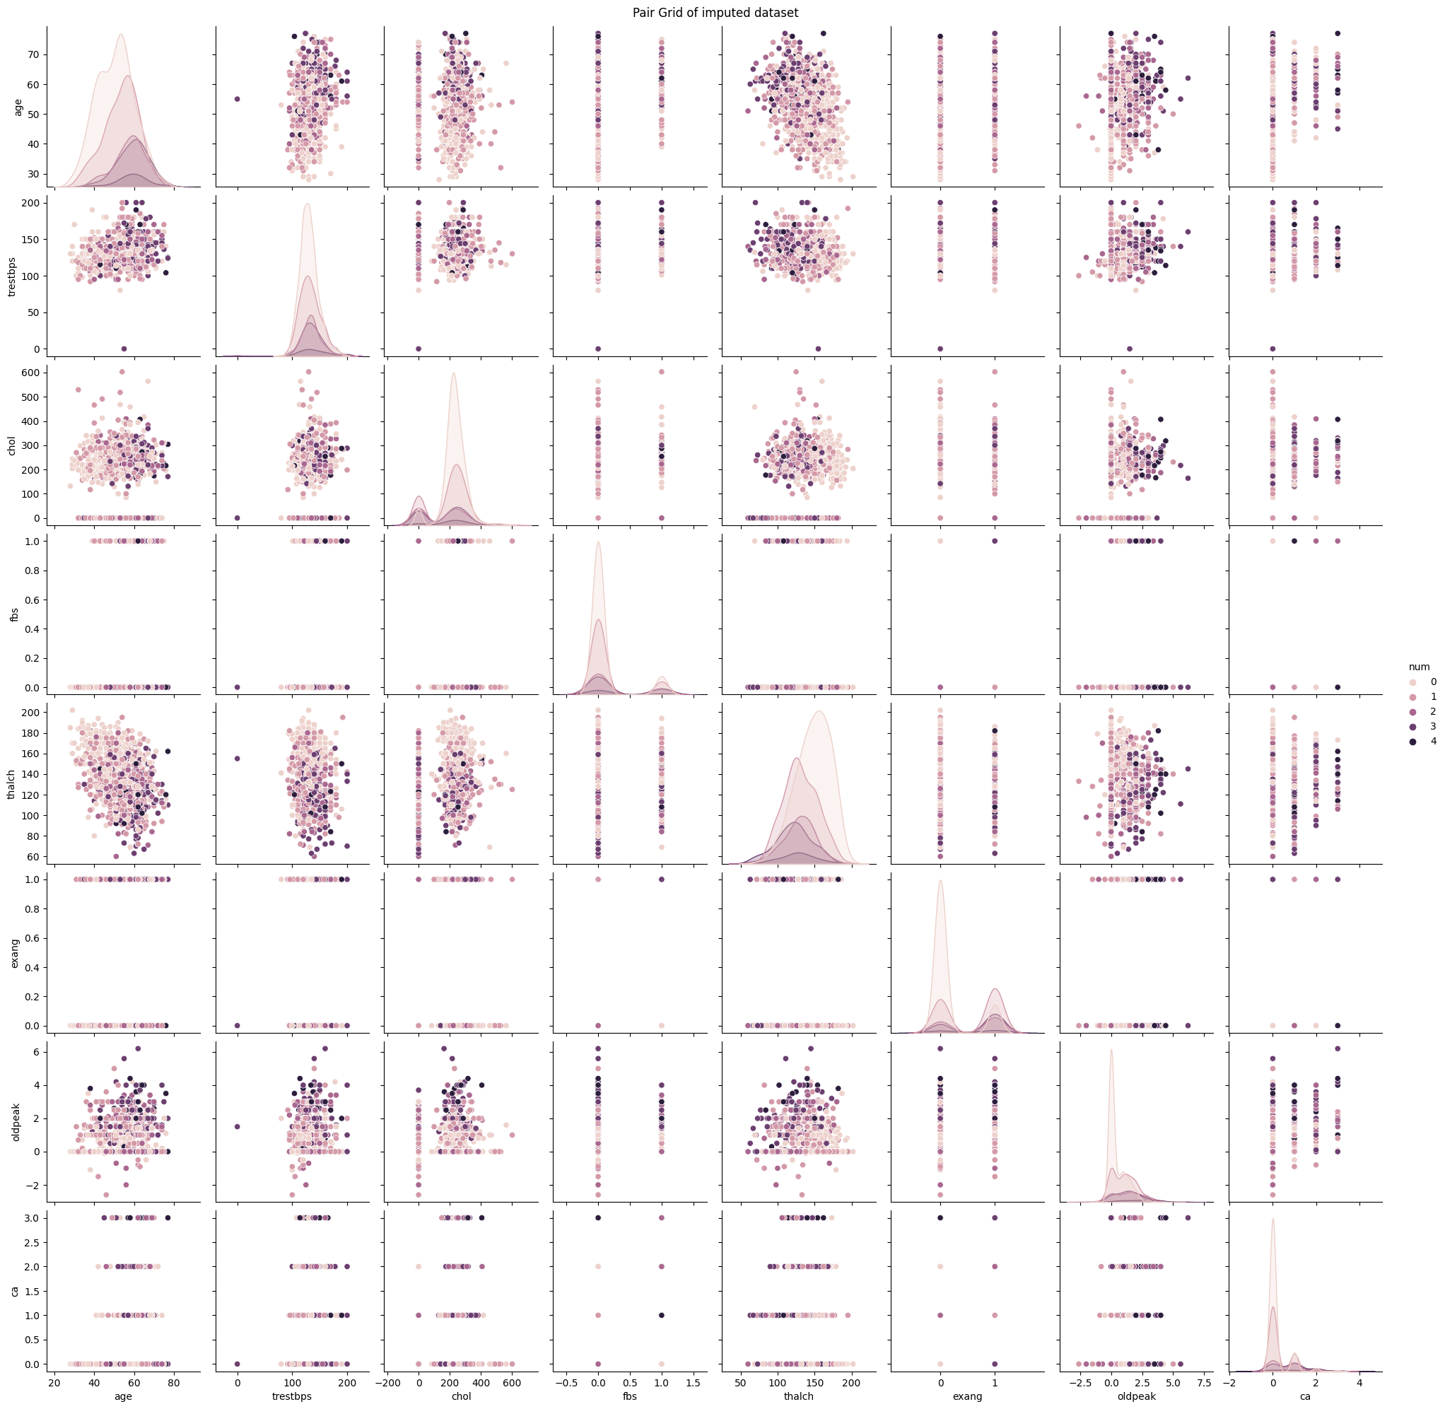
Bivariate Analysis

Slide 23
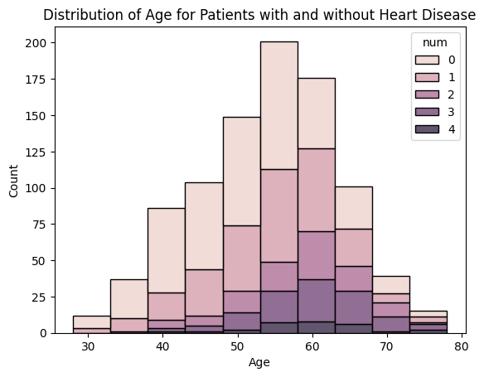
Distribution of Age Among Patients with and without Heart Disease
We can notice that people between the ages of 40 and 70 are the most affected by heart disease

Slide 24
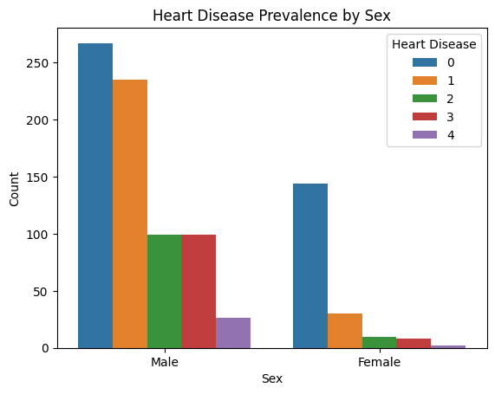
Heart Disease Prevalence by Sex
We can notice that men are more susceptible to heart disease at all levels.

Slide 25
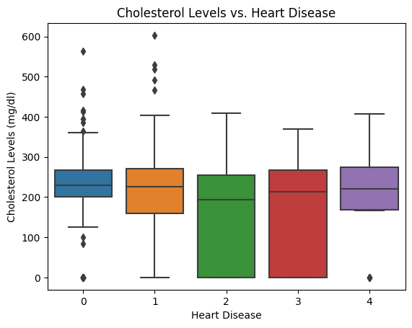
Relationship Between Cholesterol Levels and Heart Disease
The box plot illustrates cholesterol levels across five heart disease categories, showing median values, range variability, and outliers.
Categories 1 to 4 have similar medians, but the spread and outliers differ, with category 0 showing the most variability

Slide 26
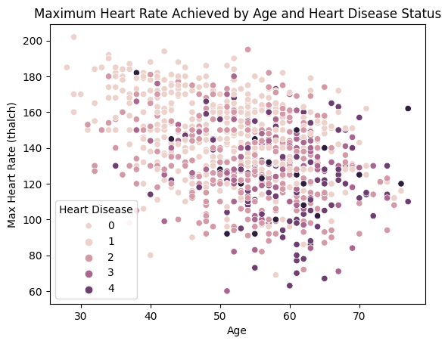
Maximum Heart Rate and Heart Disease
The plot shows a negative correlation where the maximum heart rate tends to decrease as age increases.

Slide 27
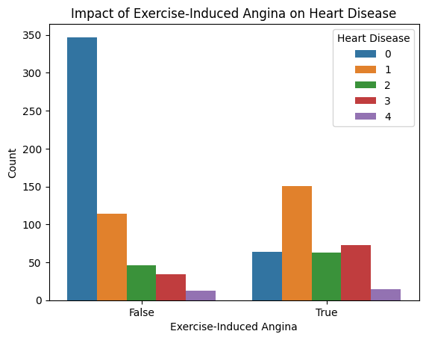
The Impact of Exercise-Induced Angina on Heart Disease
Most cases in category 0 do not report angina, while categories 1 through 4 show a more varied distribution, with both angina and non-angina cases present.
The data suggests that exercise-induced angina is more commonly reported in individuals with heart disease categories 1 to 4 compared to category 0.

Slide 28
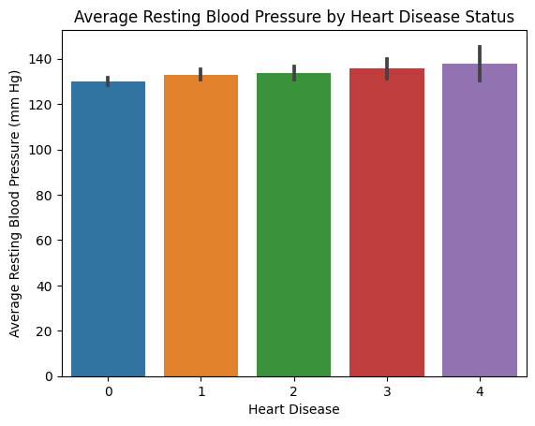
Average Resting Blood Pressure by Heart Disease Status
All categories show similar average blood pressures ranging slightly above 120 mm Hg.
The error bars indicate some variability in the measurements, with a slight trend toward increasing variability from status 0 to 4.

Slide 29
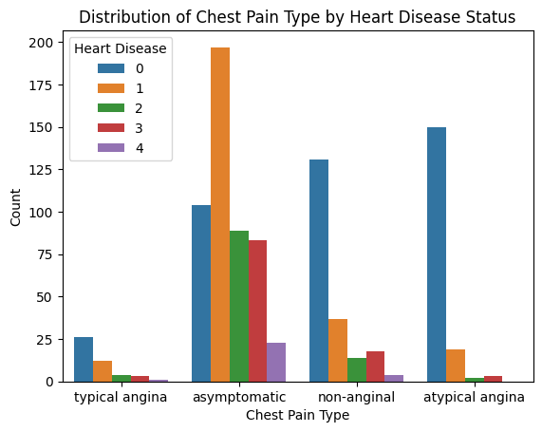
Distribution of Chest Pain Type among Patients
‘Asymptomatic' is the most common type of chest pain across all heart disease statuses except for status 0, where 'typical angina' is more prevalent.
'Non-anginal' pain is notably frequent in heart disease status 4, while 'atypical angina' is relatively less common across all states.

Slide 30
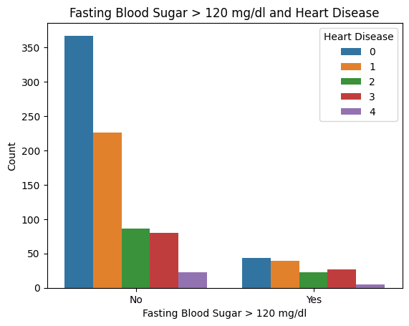
Fasting Blood Sugar and Heart Disease
The majority of individuals across all heart disease statuses have fasting blood sugar levels at or below 120 mg/dl.
For those with higher blood sugar levels, the counts are notably lower, suggesting that elevated fasting blood sugar is less common among these individuals regardless of their heart disease status.

Slide 31
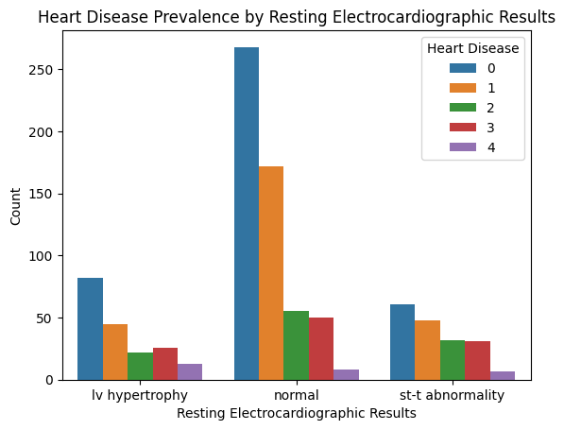
Heart Disease Prevalence by Resting Electrocardiographic Results
Most individuals with a normal ECG result fall into the '0' heart disease category, indicating no presence of heart disease.
In contrast, those with ST-T abnormalities show a higher count of heart disease statuses 1 through 4.
Left ventricular hypertrophy is less common but shows some presence across all heart disease categories.

Slide 32
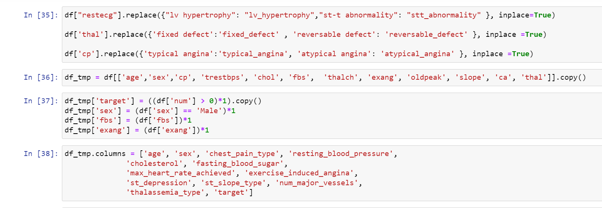
Data Preprocessing
If we just look at the data, we will see some of the features have categorical values. So we have to do one hot encoding for them. Also, the original dataset contains the target as 0, 1, 2, 3, 4. But for identifying simply the presence of disease, we will take binary classification. With that view in mind, we will convert all the target features in the num column into 1/0.

Slide 33
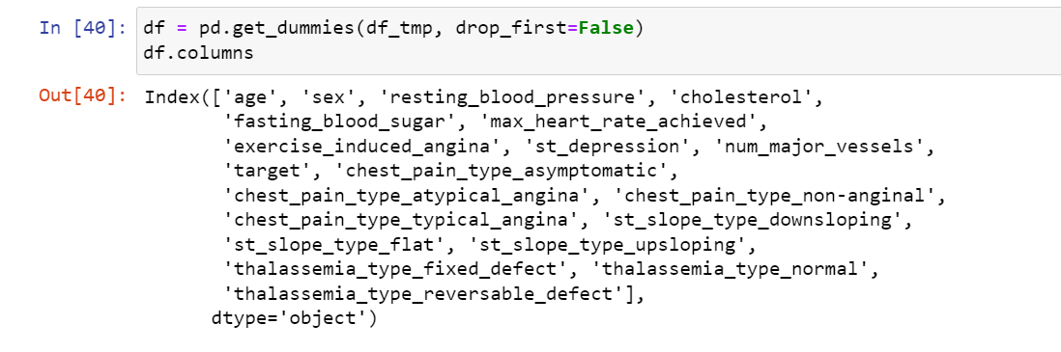
One-Hot Encoding

Slide 34
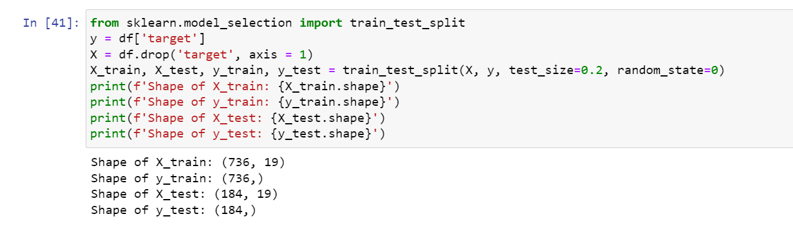
Splitting the Dependent and Independent Features
Splitting the dependent and independent features using the train test split from the sklearn library. The test size of the split is an 80-20 ratio.

Slide 35
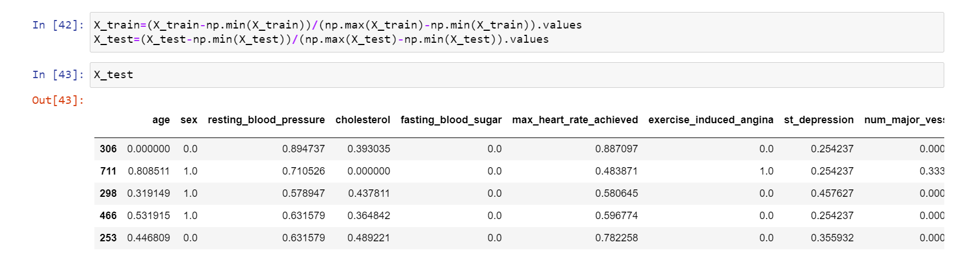
Feature Scaling
Normalization
The Min-Max Normalization method is used to Normalize the data. This method scales the data range to [0,1].

Slide 36
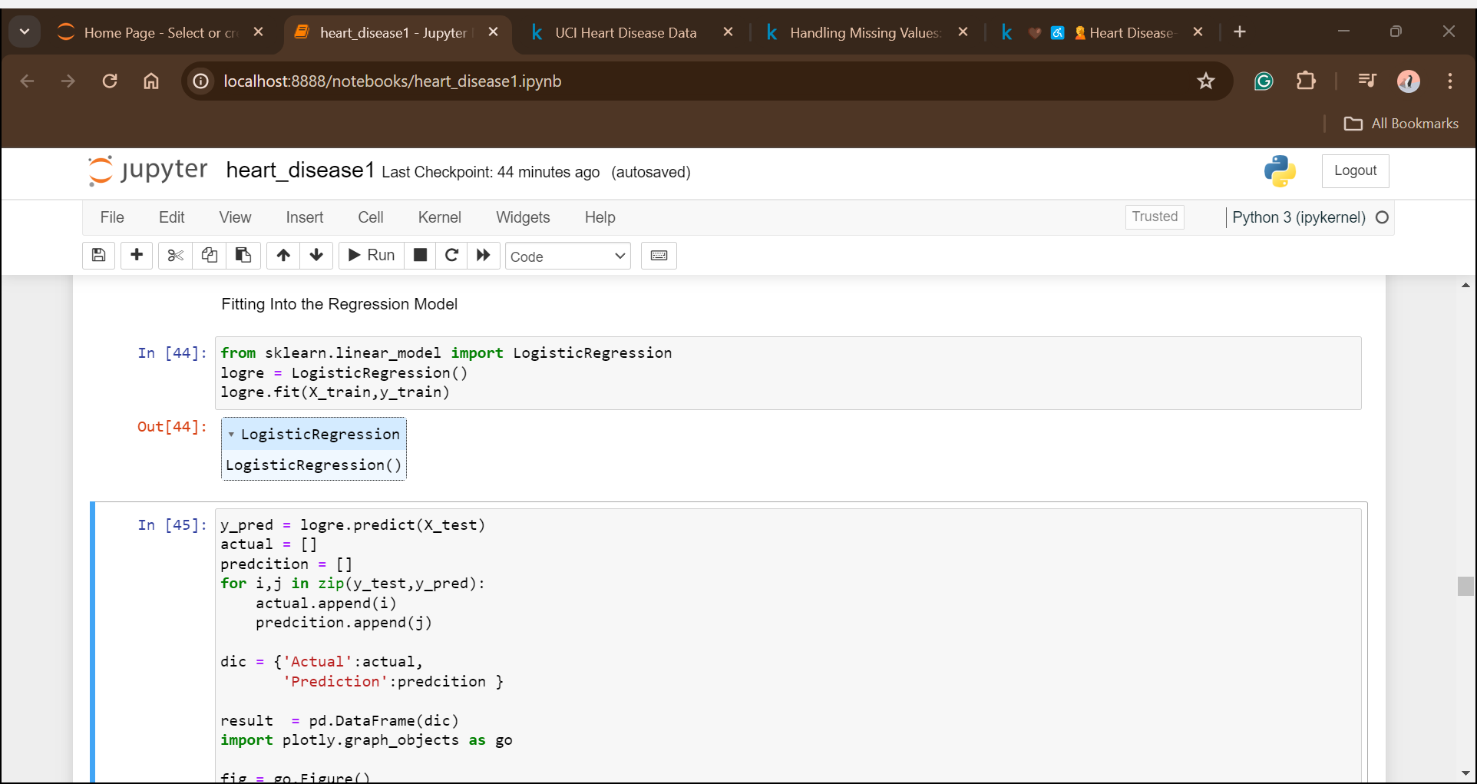
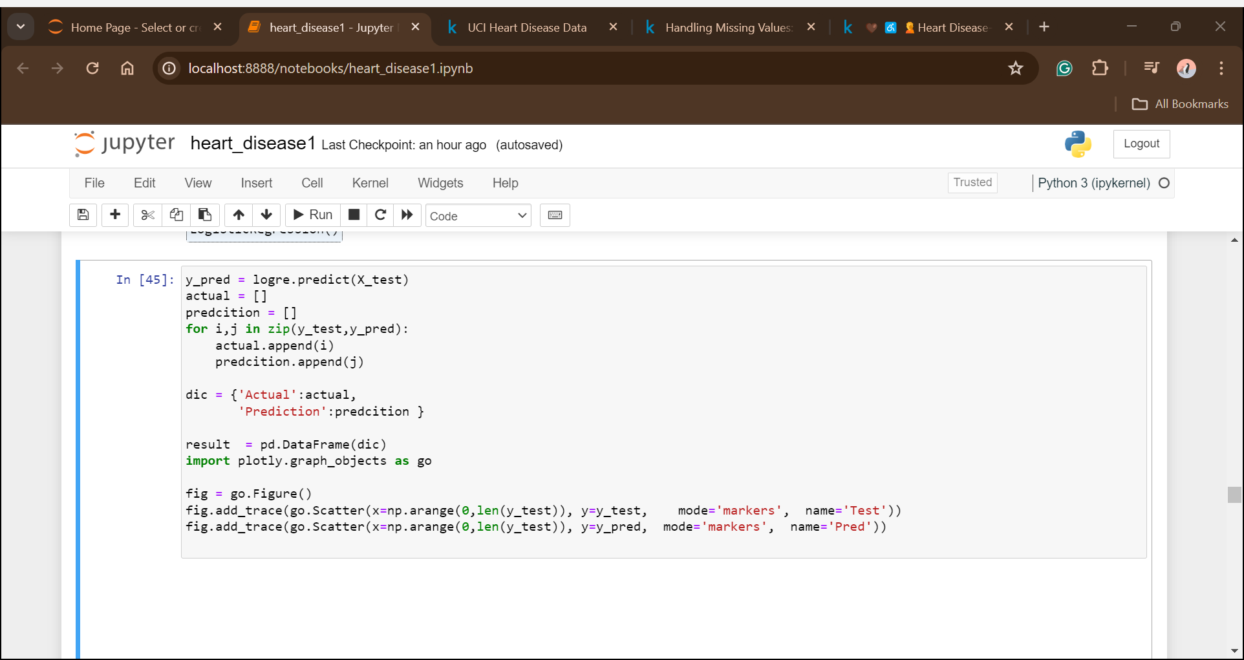
Machine Learning Model
Logistic Regression

Slide 37
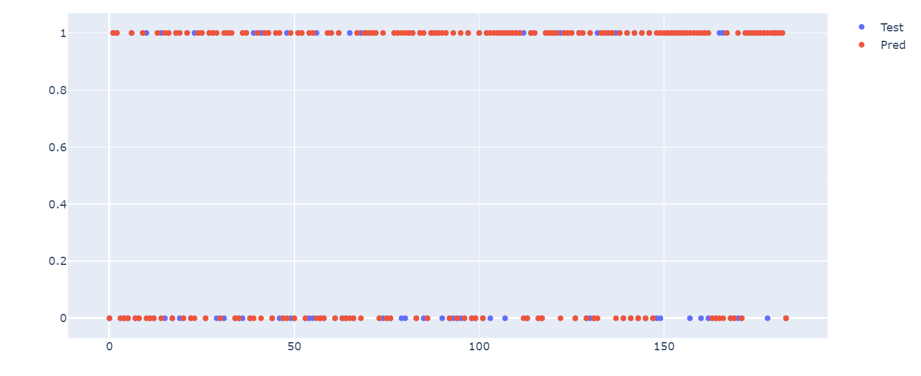
In the above figure, the red dots represent the predicted values that are either 0 or 1 and the blue line & and dot represent the actual value of that particular patient. In the places where the red dot and blue dot do not overlap are the wrong predictions and where both dots overlap those are the right predicted values.

Slide 38
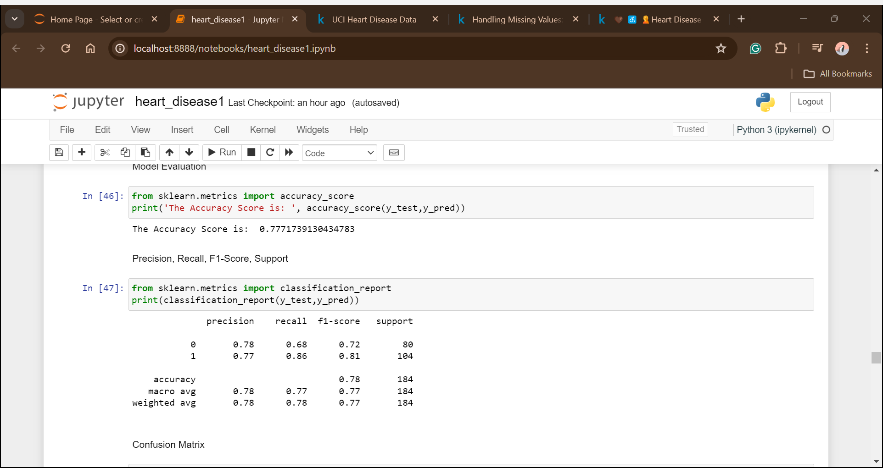
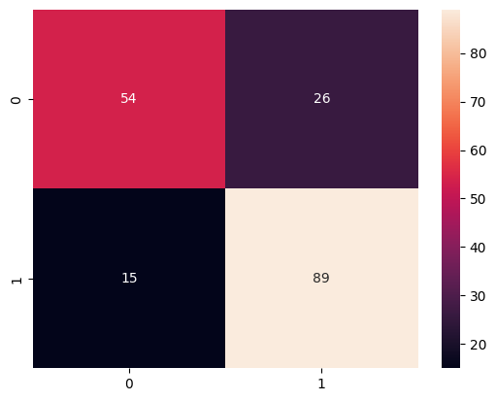
Model Evaluation
The logistic regression has given an accuracy of 77.71%.
From the confusion matrix, we can say the model can classify whether the disease is present or not. But False Positives and False Negatives are also high to reduce this we will fit another classification model.

Slide 39
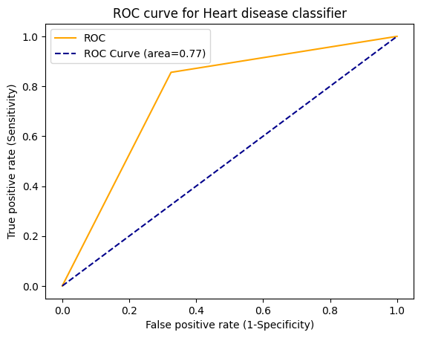
A ROC curve, or receiver operating characteristic curve, is like a graph that shows how well a classification model performs.

Slide 40
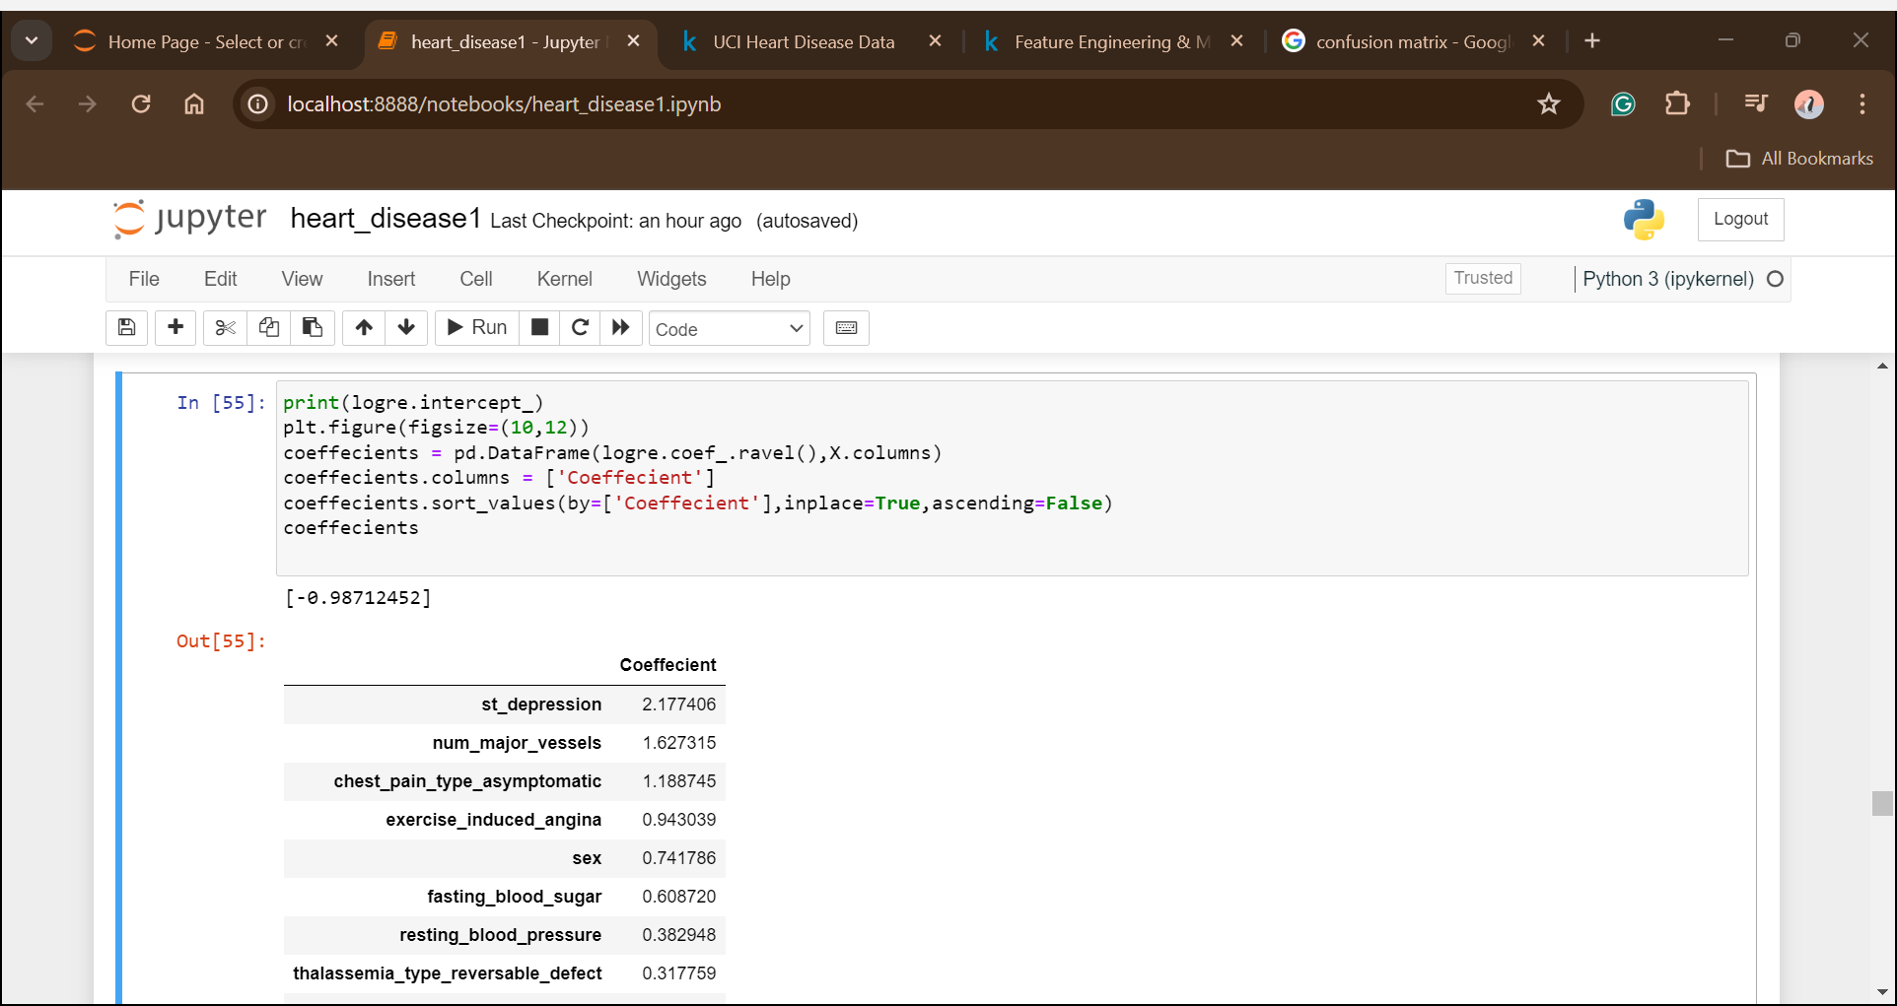
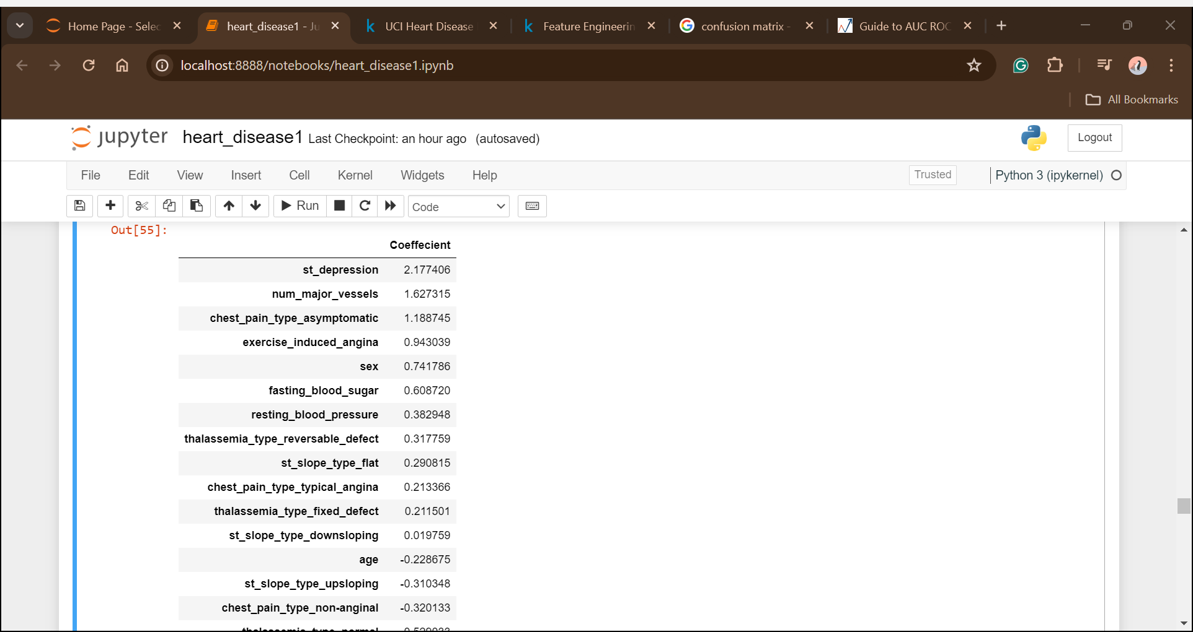
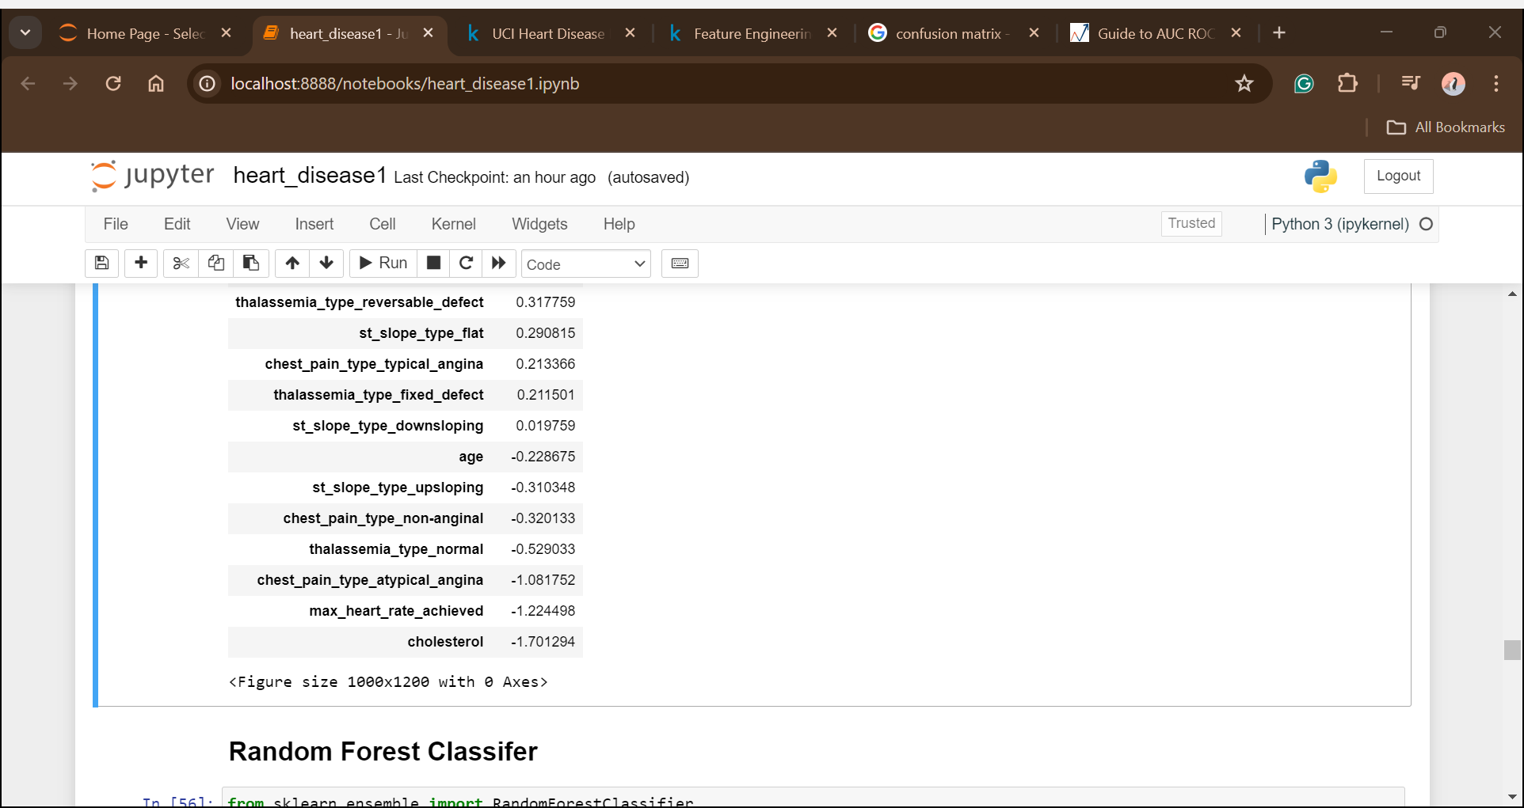
Coefficients
Linear Regression calculates the total outcome by summing up the weighted sum of the different features.

Slide 41
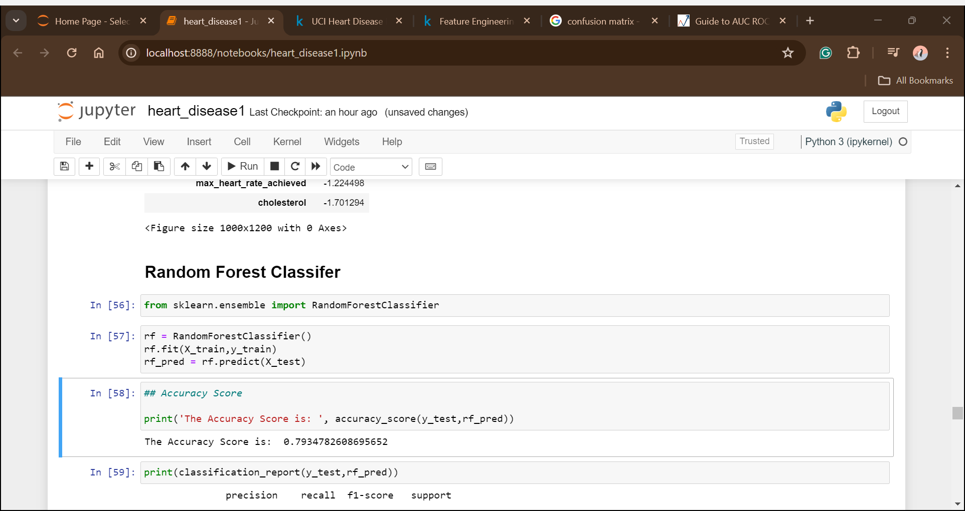
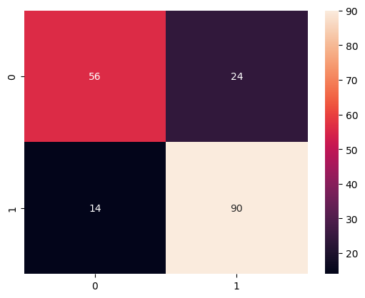
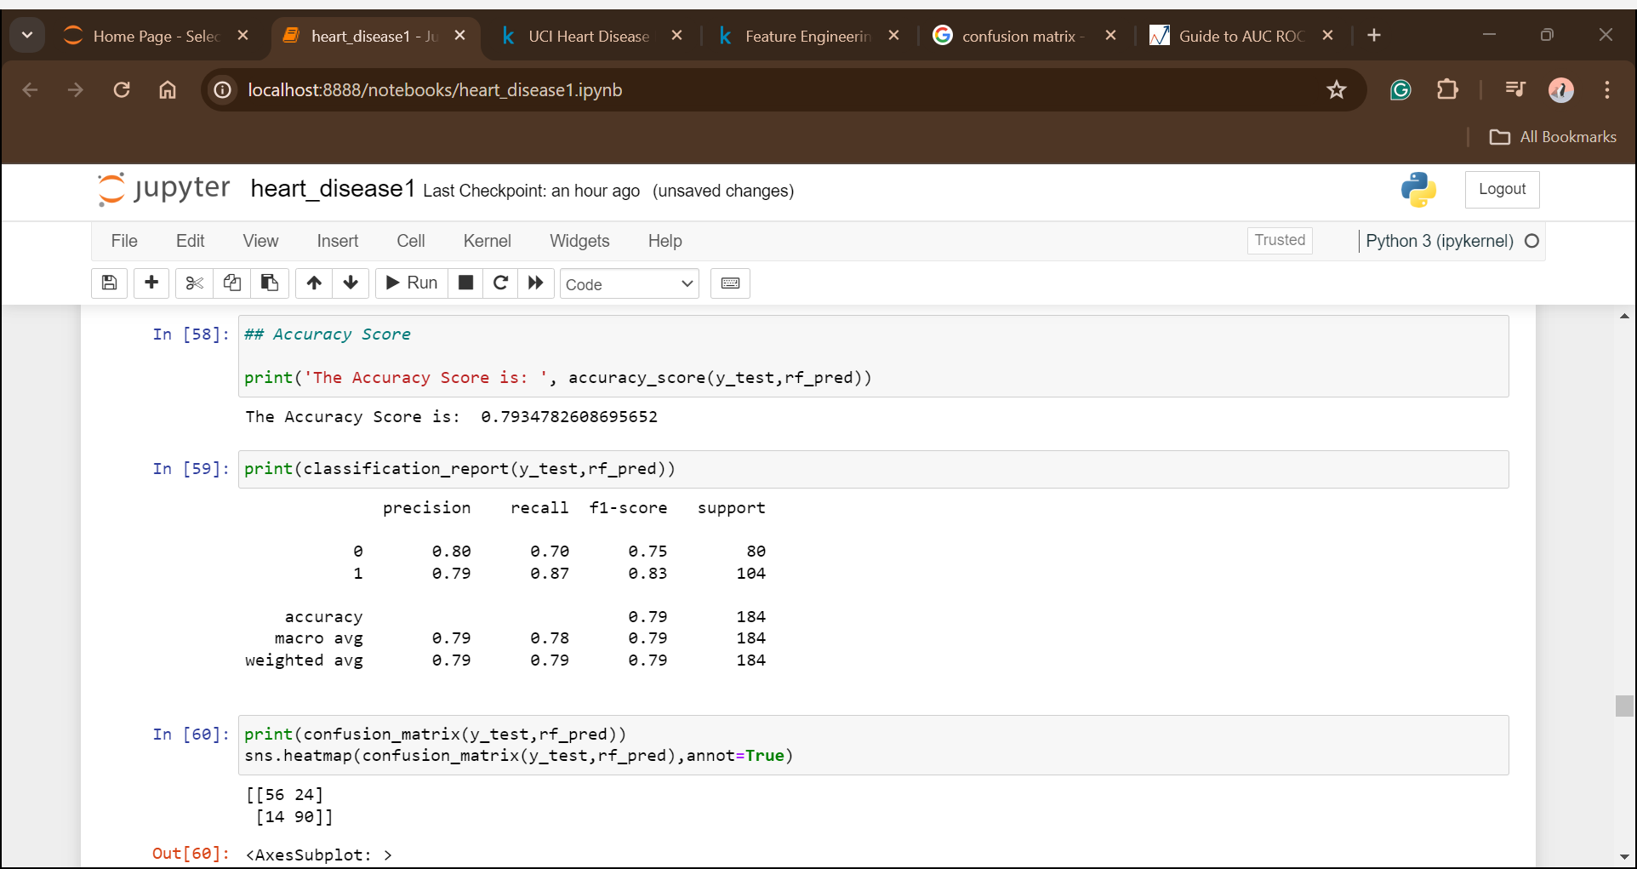
Random Forest Classifier
Random Forest has given accuracy of 79.34% which is better than Logistic Regression. Also, the precision, recall, and F1 scores improved more than in the previous model.

Slide 42
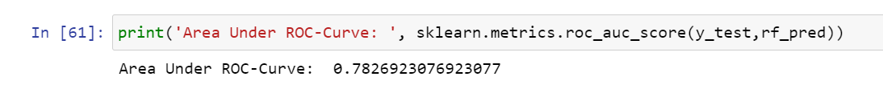
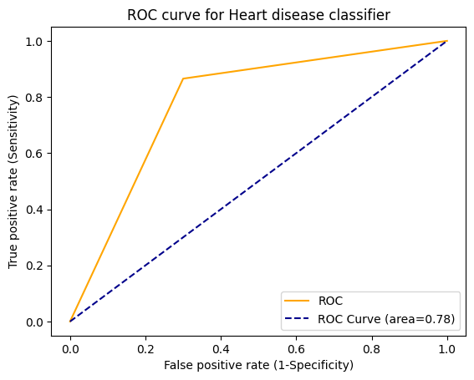

Slide 43
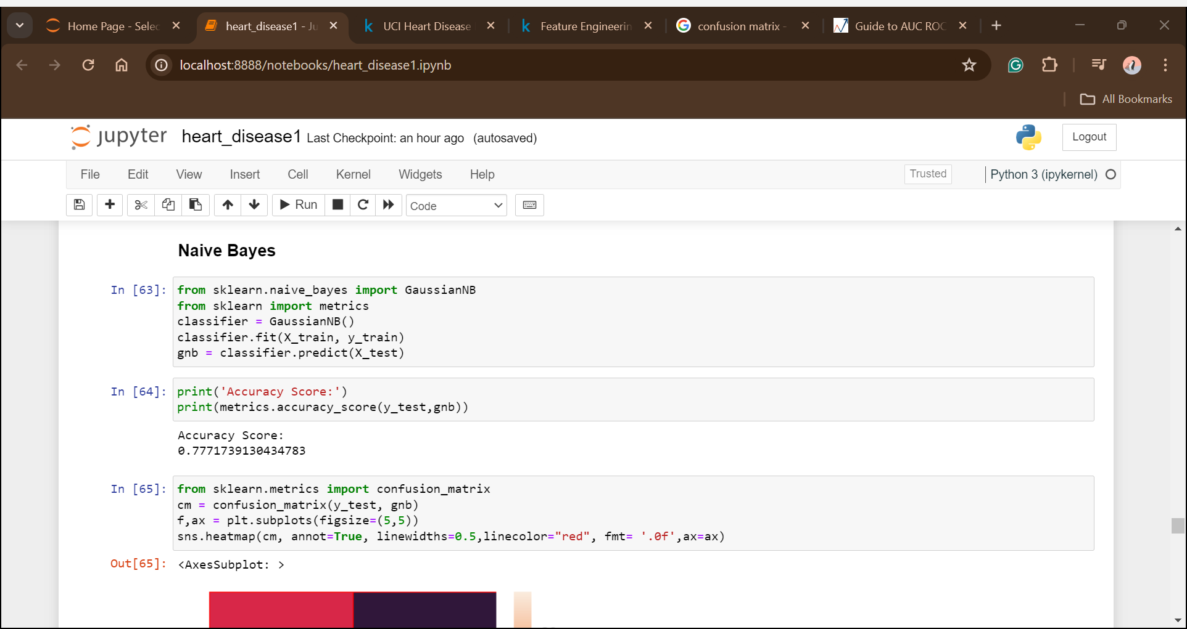


Naïve Bayes
Naïve Bayes has given an accuracy of 77.7% which is the same as Logistic Regression. Also, the precision, recall, and F1 scores have improved in this model.

Slide 44



Slide 45



Gradient Boosting Classifier
Gradient Boosting has performed better than all models till now with an accuracy of 80.43%. Also, the model can classify the whether disease is present or not more accurately.

Slide 46



Slide 47



XGBoost Classifier
After applying the Xgboost classifier the confusion matrix True positive and True Negative has increased from the previous model.

Slide 48



Slide 49




LightGBM
Here, the accuracy increased to 81.52% and also the false negative and false positive decreased making the model able to classify properly.

Slide 50



Slide 51


Hyperparameter Tuning
Hyperparameters are external configurations that guide the learning process but are not learned from the data. It involves the systematic optimization of the parameters to enhance a model's performance. This process often employs techniques like grid search, exploring different combinations of hyperparameter values to find the optimal set that maximizes model accuracy or other performance metrics.
The accuracy of Xgboost didn’t improve after doing hyperparameter tuning on data.

Slide 52


The accuracy of LightGBM also didn’t improve.

Slide 53
Model Selection
Since the accuracy of both Xgboost and LighGBM didn’t increase after tuning them with parameters. But lightGBM has a high accuracy of 82% and also the model was able to correctly classify the classes. Therefore, the LightGBM is the best model for the heart prediction data.
As per the result, the model has around 82% precision score which is quite acceptable to predict heart disease in an individual based upon the characteristics of age, sex, cp trestbps, chol, fbs, restecg, thalch, exang, oldpeak, slope, ca, thal.

Slide 54
Summary
The patients' ages range from 29 to 77 years, with an average age of 54.
The majority of the patients are male (75.9%) and the most common type of chest pain experienced by the patients is typical angina (39.6%).
The average resting blood pressure is 131.6 mmHg and the average cholesterol level is 246 mg/dL.
The average maximum heart rate achieved during exercise is 139.9 bpm.
Most patients (70.3%) do not experience exercise-induced angina.
The average ST depression induced by exercise is 1.04 mm the majority of the patients (54.8%) have a normal ECG result.
Several classification models were trained and evaluated, including Logistic Regression, Random Forest, Naive Bayes, Gradient Boosting, XGBoost, and LightGBM.
The LightGBM model achieved the highest accuracy of 80.97% after hyperparameter tuning.
The ROC curves and AUC scores for each model were analyzed to assess their performance.
The results suggest that the XGBoost and LightGBM models are suitable for predicting the presence or absence of heart disease based on the available features.

Slide 55


